Slide 1
SQL:
Structured Query Language
A standard computer database language for accessing and manipulating database systems.

Slide 2
SQL
SQL is a transform-oriented language with 2 major components
Data Definition Language (DDL). for defining database structure.
Data Manipulation Language (DML). for retrieving and updating data.
A DDL
A DML

Slide 3
Introduction
Purpose and importance of SQL.
How to retrieve data from database using SELECT and:
Use compound WHERE conditions.
Sort query results using ORDER BY.
Use aggregate functions.
Group data using GROUP BY and HAVING.
How to update database using INSERT, UPDATE, and DELETE.

Slide 4
Objectives
Introduction to SQL: Data Definition & Data Manipulation
Writing SQL commands – The rules of the game
Creating Tables and Populating them with data
Retrieving data from the tables
Projection and Selection Operations
SELECT
Use of DINSTINCT
Calculated Fields
Search (Using WHERE clause)
Compound Search
Range Search

Slide 5
Understanding SQL
Ideally, database language should allow user to:
create the database and relation structures;
perform insertion, modification, deletion of data from relations;
perform simple and complex queries.
Must perform these tasks with minimal user effort and command structure/syntax must be easy to learn.

Slide 6
Understanding SQL
SQL is relatively easy to learn:
it is non-procedural - you specify what information you require, rather than how to get it;

Slide 7
Understanding SQL
Consists of standard English words e.g:
1.CREATE TABLE Staff(staffNo VARCHAR(5), lName VARCHAR(15), salary int);
2.INSERT INTO Staff VALUES ('SG16', 'Brown', 8300);
3. SELECT staffNo, lName, salary
FROM Staff WHERE salary > 10000;

Slide 8
Understanding SQL
Can be used by range of users including DBAs, application developers, and other types of end users.
An ISO standard now exists for SQL, making it the formal language for relational databases.

Slide 9
Writing SQL Commands (syntax)
SQL statement consists of reserved words and user-defined words.
Reserved words are a fixed part of SQL and must be spelt exactly as required and cannot be split across lines.
User-defined words are made up by user and represent names of various database objects such as relations, columns, views.

Slide 10
Writing SQL Commands (syntax)
Most components of an SQL statement are case insensitive, except for literal character data.
More readable with indentation and lineation (though these are optional) i.e:
- Each clause should begin on a new line.
- If clause has several parts, each should appear on a separate line and be indented under start of clause.

Slide 11
Writing SQL Commands (syntax)
- Upper-case letters represent reserved words.
- Lower-case letters represent user-defined words.
- Curly braces ({}) indicate a required element.
- Square brackets ([]) indicate an optional element.

Slide 12
Literals
Literals are constants used in SQL statements.
All non-numeric literals must be enclosed in single quotes (e.g. ‘Mukono’).
All numeric literals must not be enclosed in quotes (e.g. 650.00).

Slide 13
SELECT Statement
SELECT Specifies which columns are to
appear in output.
FROM Specifies table(s) to be used.
WHERE Filters rows using a given condition.
GROUP BY Forms groups of rows with the same
column value.
HAVING Filters/groups subject according to some condition.
ORDER BY Specifies the order of the output.

Slide 14
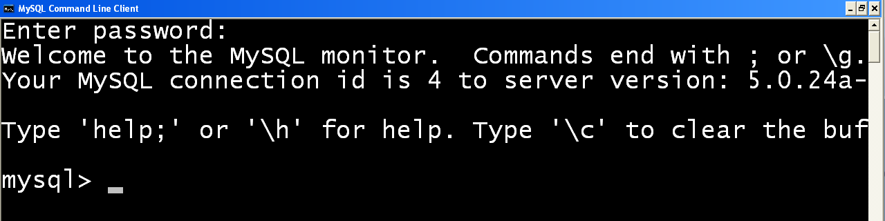
Getting Started – Using MySQL RDBMS
Logging into the mysql server
Open the command prompt & enter the command below
> mysql –h localhost –u root –p
Viewing the available databases
>show databases;

Slide 15
Getting Started – Using MySQL RDBMS
Creating a database in MySQL
>create database demo;
Using a particular database
>use demo;
Viewing the tables in the database
>show tables;
Deleting/dropping databases
>drop database demo;

Slide 16
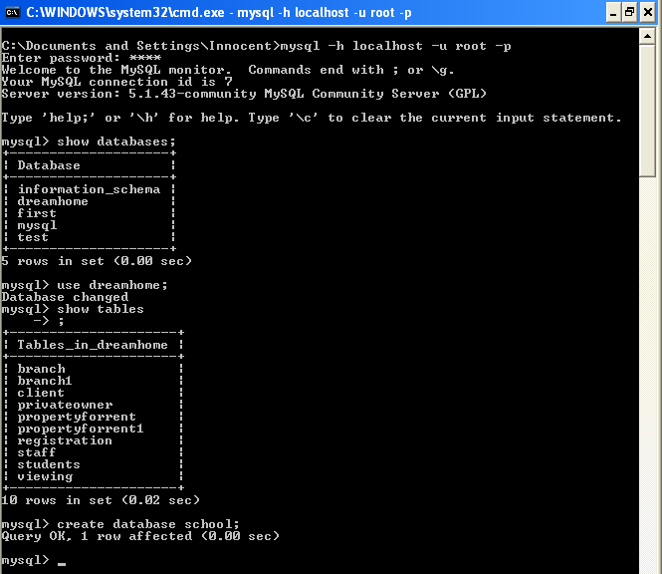
Sample commands & output

Slide 17
Data Retrieval from one Table
Four major scenarios of data retrieval from a single table:
Retrieving all columns and all rows;
Retrieving specific columns and all rows;
Retrieving all columns and specific rows;
Retrieving specific columns and specific rows.

Slide 18
SELECT Statement
Order of the clauses cannot be changed.
Only SELECT and FROM are mandatory.

Slide 19
Example 5.1 All Columns, All Rows
Request: List full details of all staff.
SELECT staffNo, fName, lName, address,
position, sex, DOB, salary, branchNo
FROM Staff;
Can use * as an abbreviation for 'all columns':
SELECT *
FROM Staff;

Slide 20
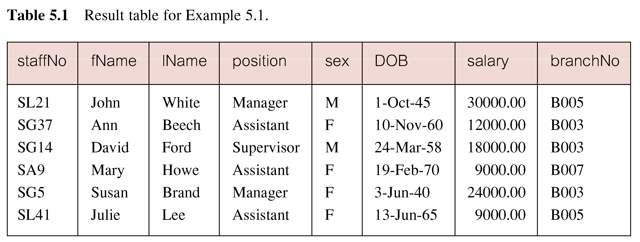
Example 5.1 All Columns, All Rows

Slide 21
Data type
Indicates the type of data that can be represented in the value of the data element.
Types of Data types that can be used in SQL.
- int , Char(10), Varchar(15), Date.
Why Data types are relevant. ???
Operators work on particular fields based on a data type assigned.

Slide 22
Example 5.2 Specific Columns, All Rows
Produce a list of salaries for all staff, showing only staff number, first and last names, and salary.
SELECT staffNo, fName, lName, salary
FROM Staff;

Slide 23
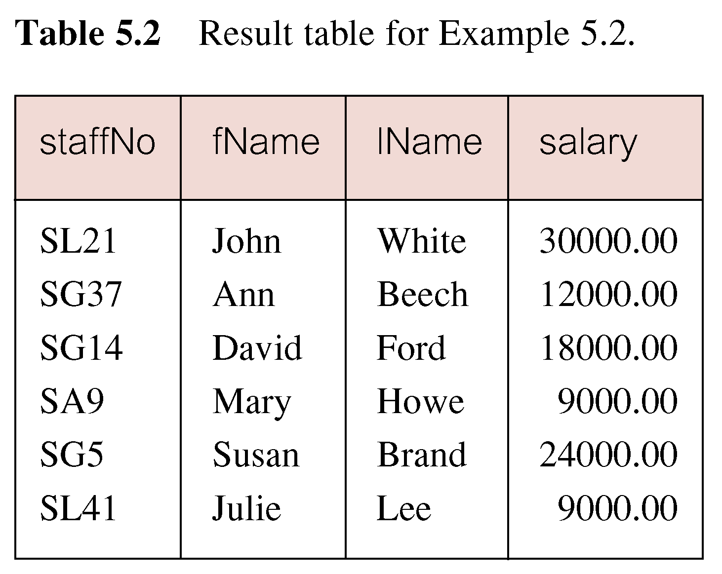
Example 5.2 Specific Columns, All Rows

Slide 24
Distinct Key word
Distinct is used to retrieve rows of your database that have unique values for a given column. For example say we have a table of employees and in this table of employees we have several job titles from janitors to CEOs. We would like to know just how many distinct job titles we have.
some of the columns may contain duplicate values.

Slide 25
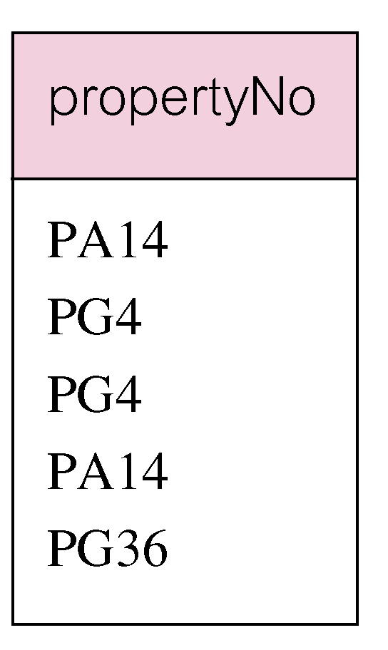
Example 5.3 Use of DISTINCT
List the property numbers of all properties that have been viewed.
SELECT propertyNo
FROM Viewing;

Slide 26
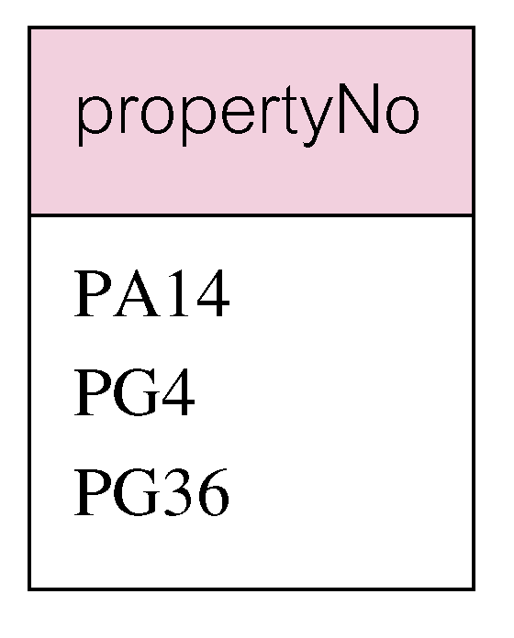
Example 5.3 Use of DISTINCT
Use DISTINCT to eliminate duplicates:
SELECT DISTINCT propertyNo
FROM Viewing;

Slide 27
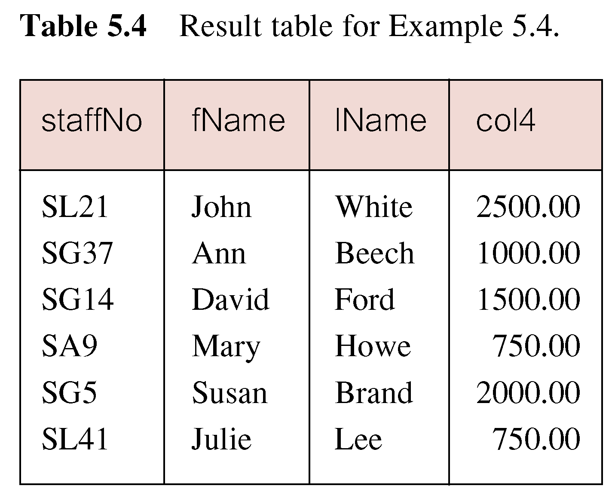
Example 5.4 Calculated Fields
Produce a list of monthly salaries for all staff, showing staff number, first and last names, and salary details.
SELECT staffNo, fName, lName, salary/12 FROM Staff; (salary is divided by 12 to calculate the monthly salary from the annual salary)

Slide 28
Example 5.4 Naming columns
To name column, use AS clause:
SELECT staffNo, fName, lName, salary/12
AS monthlySalary
FROM Staff;
QN: Write an SQL statement that will increase salaries of all position =Assistant
by 15000.

Slide 29
Comparison Search Condition
This is done using the WHERE clause. General syntax:
SELECT clause
FROM table
WHERE condition;
Comparison operators are used to define conditions in the where clause
>, <,>=,<=, =.

Slide 30
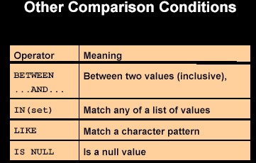

Slide 31
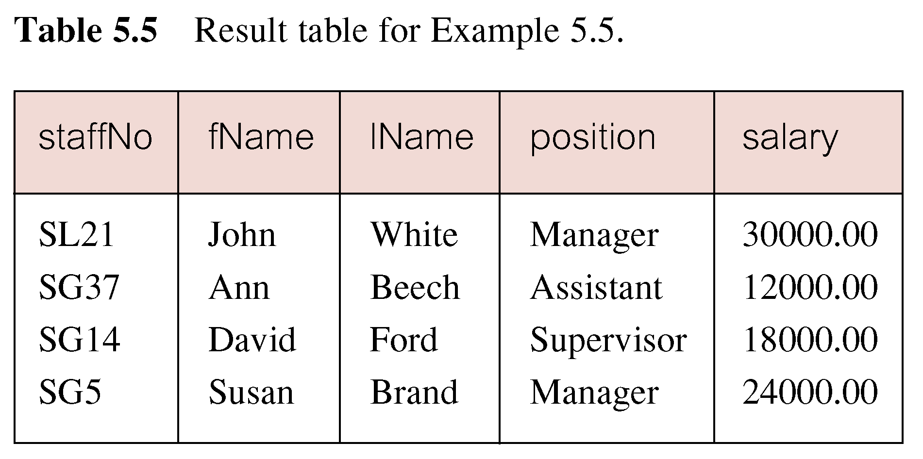
Comparison Search Condition
List all staff with a salary greater than 10,000.
SELECT staffNo, fName, lName, position, salary
FROM Staff
WHERE salary > 10000;

Slide 32
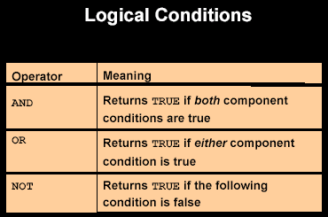

Slide 33
Comparison Operators
= equals
< is less than
> is less than
!= Not Equal
>= greater than or equal to.
<= Less than or equal to

Slide 34
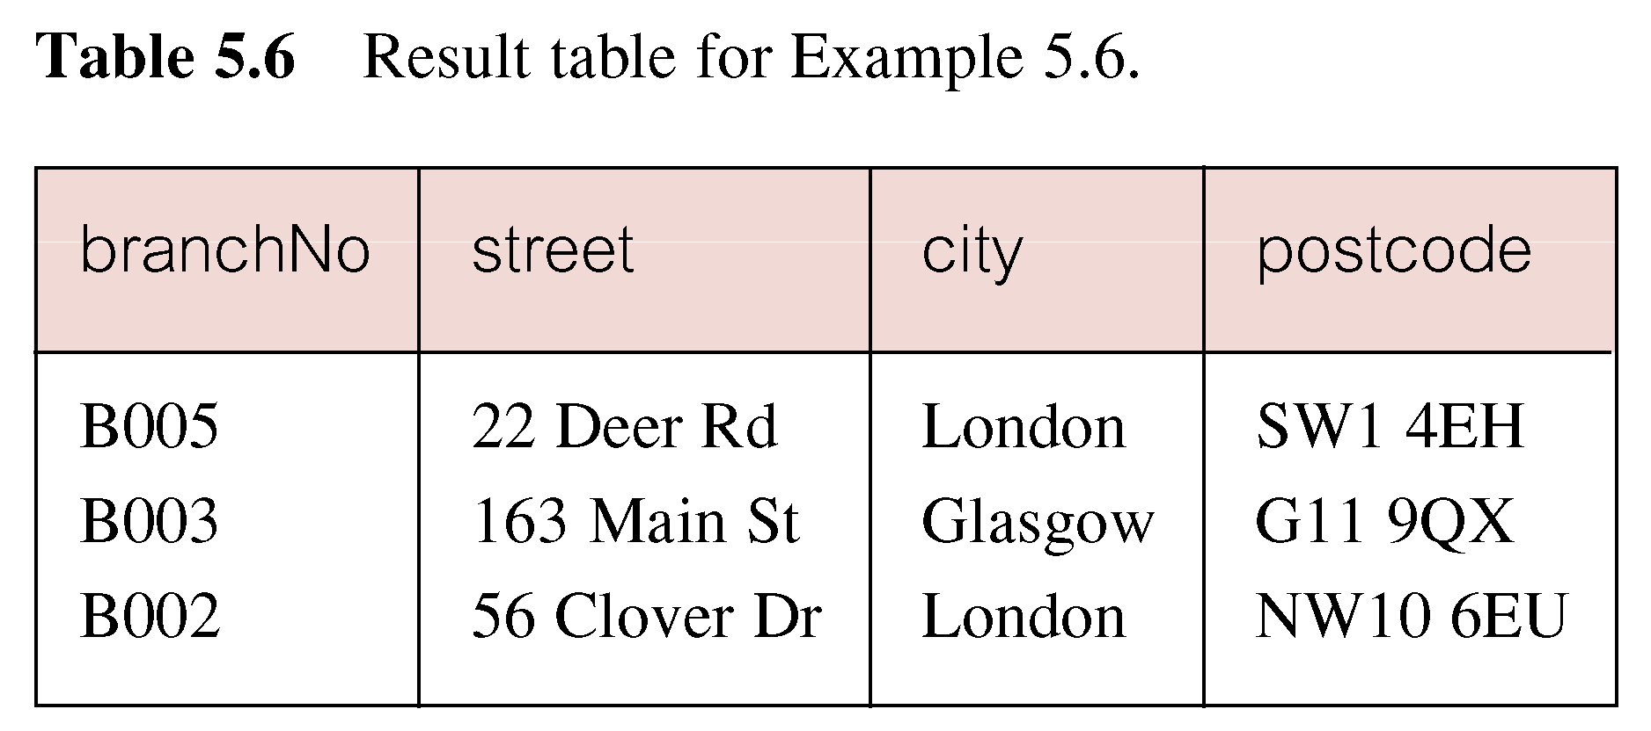
Example 5.6 Compound Comparison Search Condition
List addresses of all branch offices in London or Glasgow.
SELECT *
FROM Branch
WHERE city = 'London' OR city = 'Glasgow';

Slide 35
Compound Comparison Search Condition
List all positions that are Managers or sex =M.
List all positions that are Managers and sex =M.

Slide 36
Example 5.7 Range Search Condition
BETWEEN test includes the endpoints of range.
List all staff with a salary between 20,000 and 30,000.
SELECT staffNo, fName, lName, position, salary
FROM Staff
WHERE salary BETWEEN 20000 AND 30000;

Slide 37
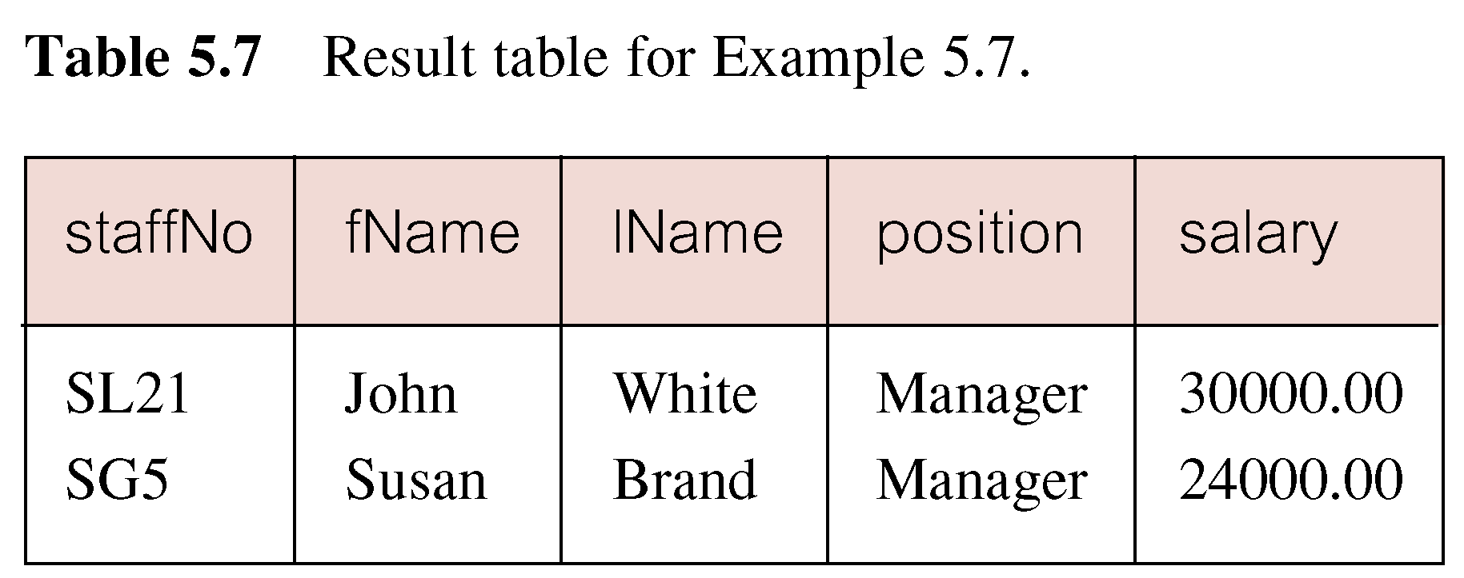
Example 5.7 Range Search Condition

Slide 38
Example 5.7 Range Search Condition
Also a negated version, NOT BETWEEN can be used.
BETWEEN does not add much to SQL's expressive power Could also write:
SELECT staffNo, fName, lName, position, salary
FROM Staff
WHERE salary>=20000 AND salary <= 30000;
Useful, though, for a range of values.
QN : Write an SQL statement that will retrieve all the fname after SUZAN??

Slide 39
IN Clause
IN clause :is a special kind of operator for use in your where clauses.
Recall that in a where expression only one value is allowed to be sent through the query. With the in operator one can send multiple values in the where clause.

Slide 40
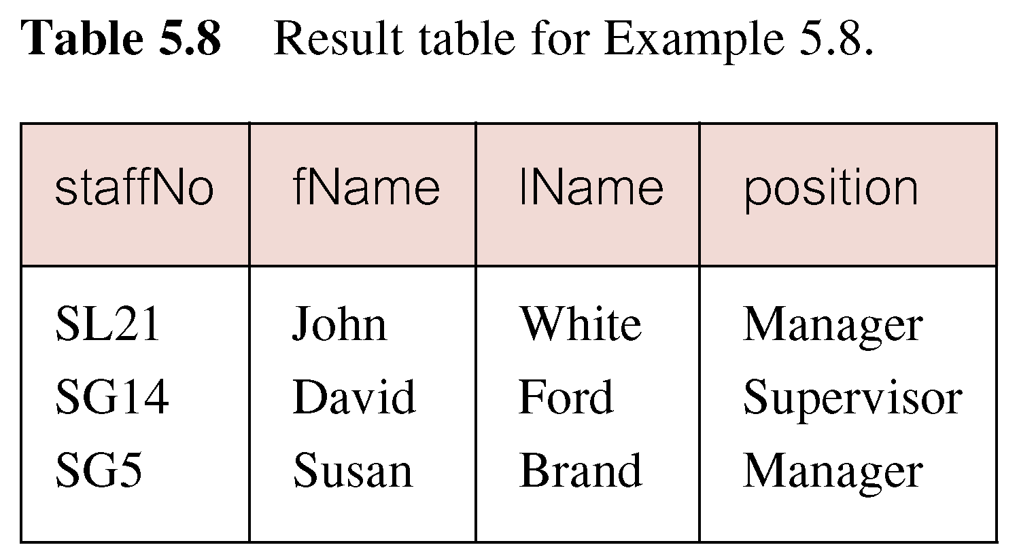
Example 5.8 Set Membership
List all managers and supervisors.
SELECT staffNo, fName, lName, position
FROM Staff
WHERE position IN ('Manager', ‘Supervisor');

Slide 41
Example 5.8 Set Membership
There is a negated version (NOT IN).
IN does not add much to SQL's expressive power.
Could have expressed this as:
SELECT staffNo, fName, lName, position
FROM Staff
WHERE position='Manager' OR
position=‘Supervisor';
IN is more efficient when set contains many values.

Slide 42
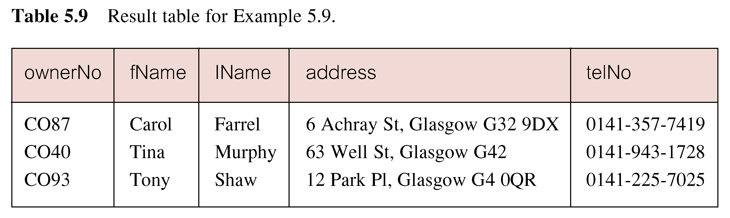
Pattern Matching
Find all owners with the string 'Glasgow' in their address.
SELECT clientNo, fName, lName, address, telNo
FROM PrivateOwner
WHERE address LIKE '%Glasgow%';

Slide 43
Pattern Matching
SQL has two special pattern matching symbols.
LIKE '%Glasgow%' means a sequence of characters of any length containing 'Glasgow'.
Like ‘n%’ ; Starts with letter n.
Like ‘%w’ ; Ends with a letter w.

Slide 44
NULL Search Condition
List details of all viewings on property PG4 where a comment has not been supplied.
Null represents a value for an attribute that is currently unknown or not applicable for a tuple.
Have to test for null explicitly using special keyword IS NULL:
SELECT clientNo, viewDate
FROM Viewing
WHERE propertyNo = 'PG4' AND
comment IS NULL;

Slide 45
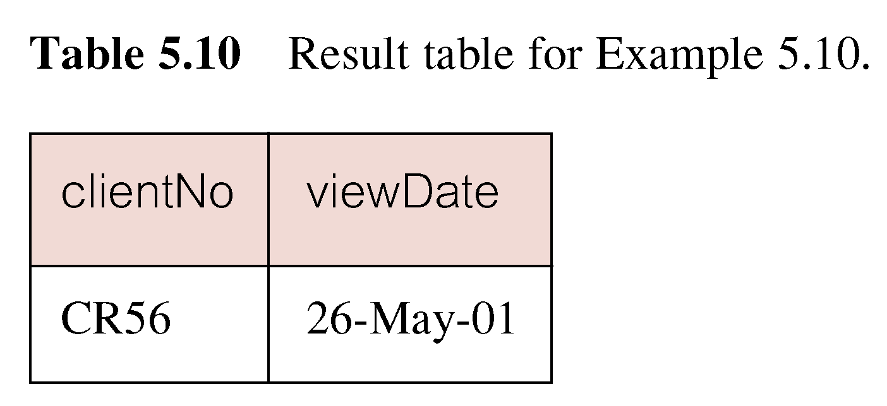
Example 5.10 NULL Search Condition
Negated version (IS NOT NULL) can test for non-null values.

Slide 46
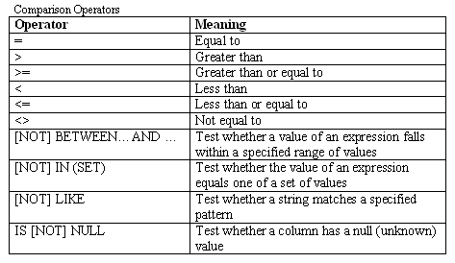
Row Selection Cont’d
Note
Character strings and dates in the where clause must be enclosed in single quotation marks (‘ ‘). Numeric constants should not be enclosed in single quotation marks.
All character searches are case sensitive.

Slide 47
SQL - Order By
The order by statement allows for table column assortment. It allows for ascending or descending lists of your table column values permitting SQL to re-order your table rows for the purpose of viewing.

Slide 48
Single Column Ordering
List salaries for all staff, arranged in descending order of salary.
SELECT staffNo, fName, lName, salary FROM Staff
ORDER BY salary DESC;

Slide 49
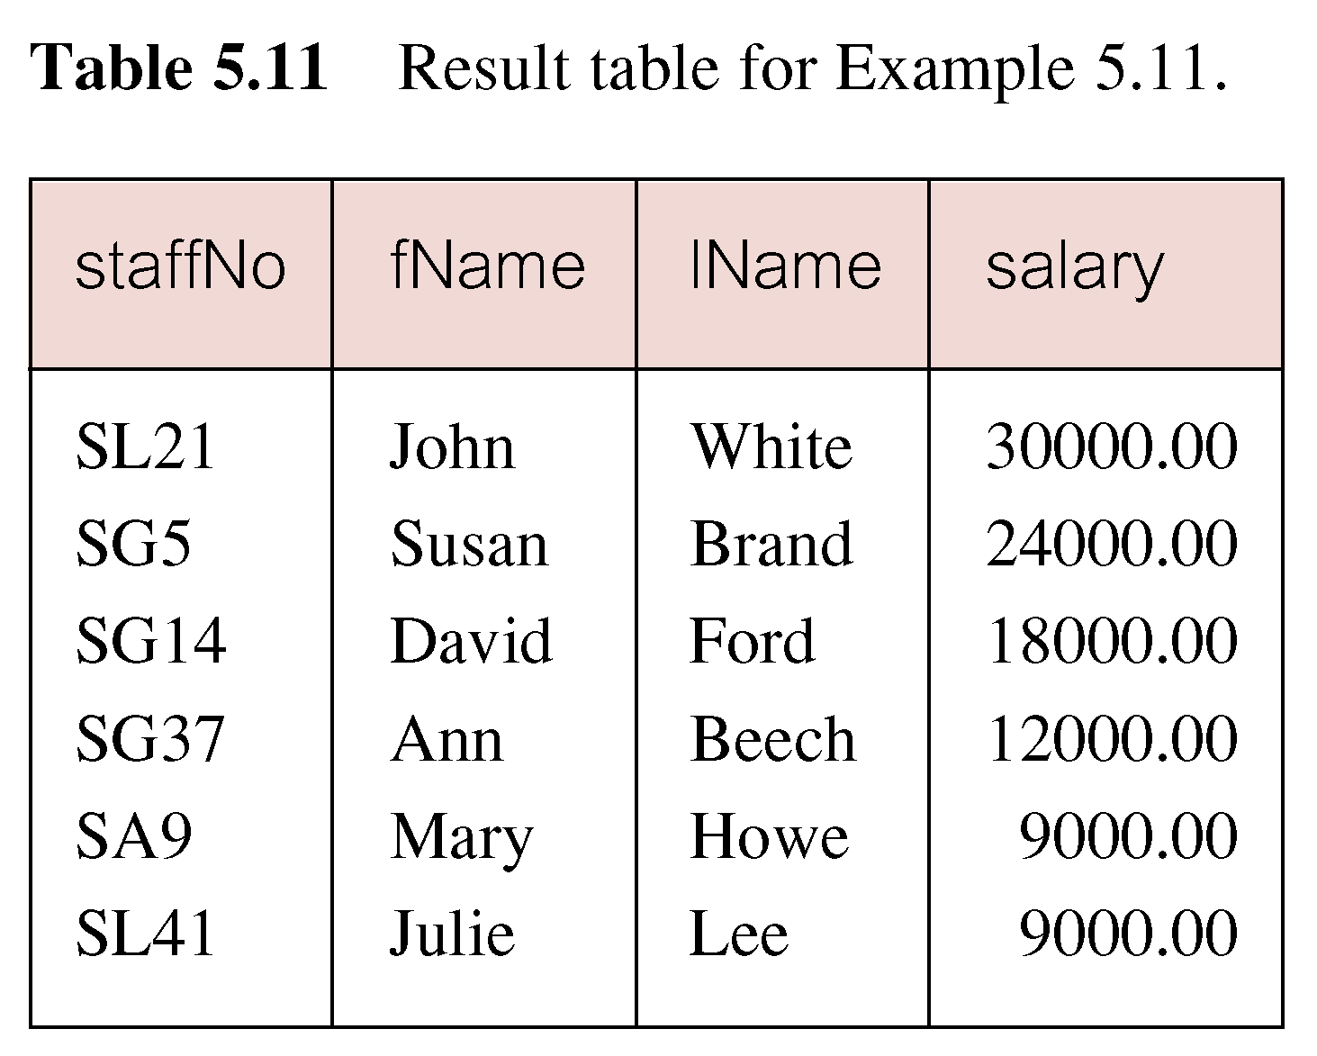
Example 5.11 Single Column Ordering

Slide 50
Example 5.12 Multiple Column Ordering
Produce abbreviated list of properties in order of property type.
SELECT propertyNo, type, rooms, rent
FROM PropertyForRent
ORDER BY type;

Slide 51
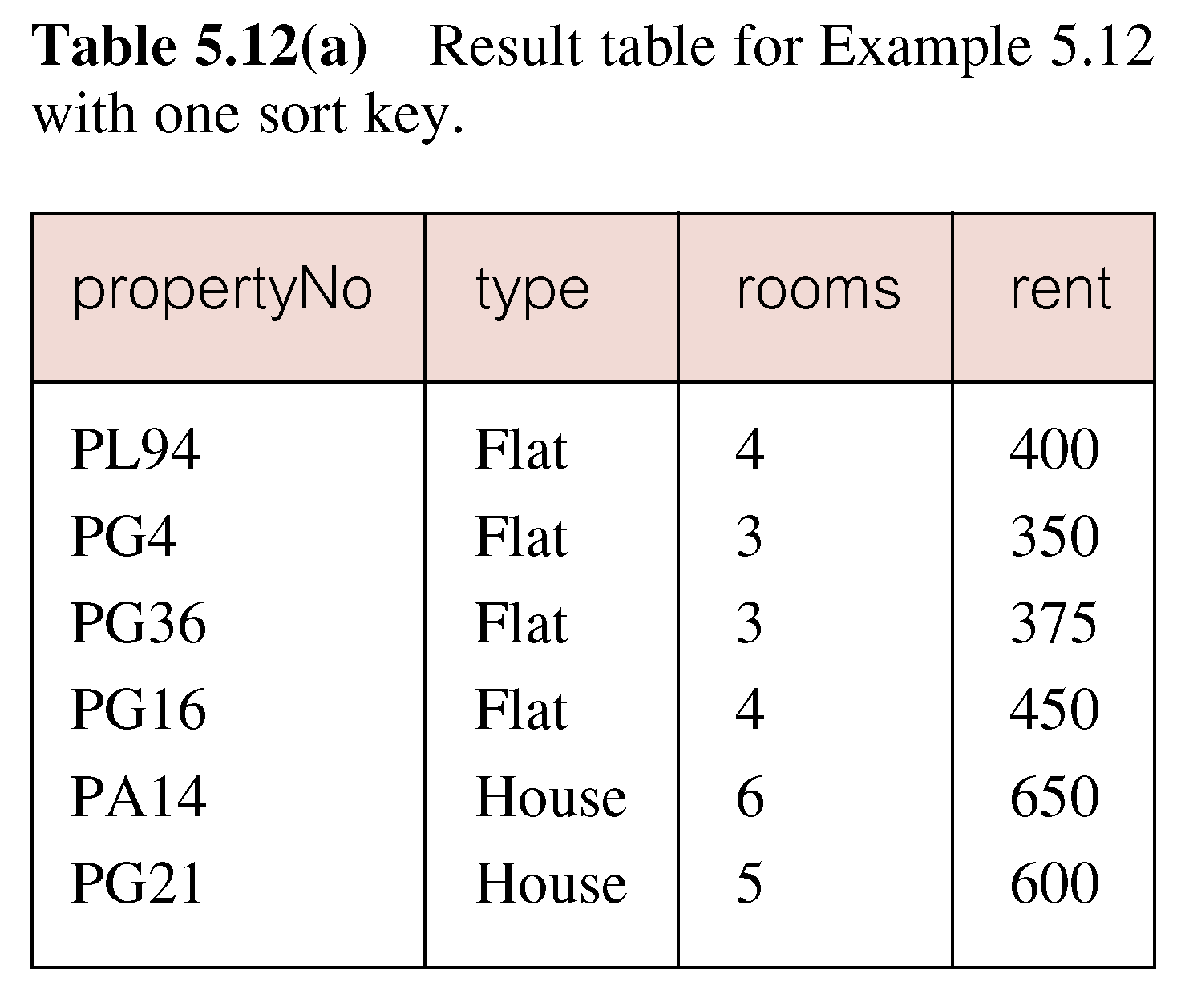
Example 5.12 Multiple Column Ordering

Slide 52
Multiple Column Ordering
Four flats in this list - as no minor sort key specified, system arranges these rows in any order it chooses.
To arrange in order of rent, specify minor order:
SELECT propertyNo, type, rooms, rent
FROM PropertyForRent
ORDER BY type, rent DESC;

Slide 53
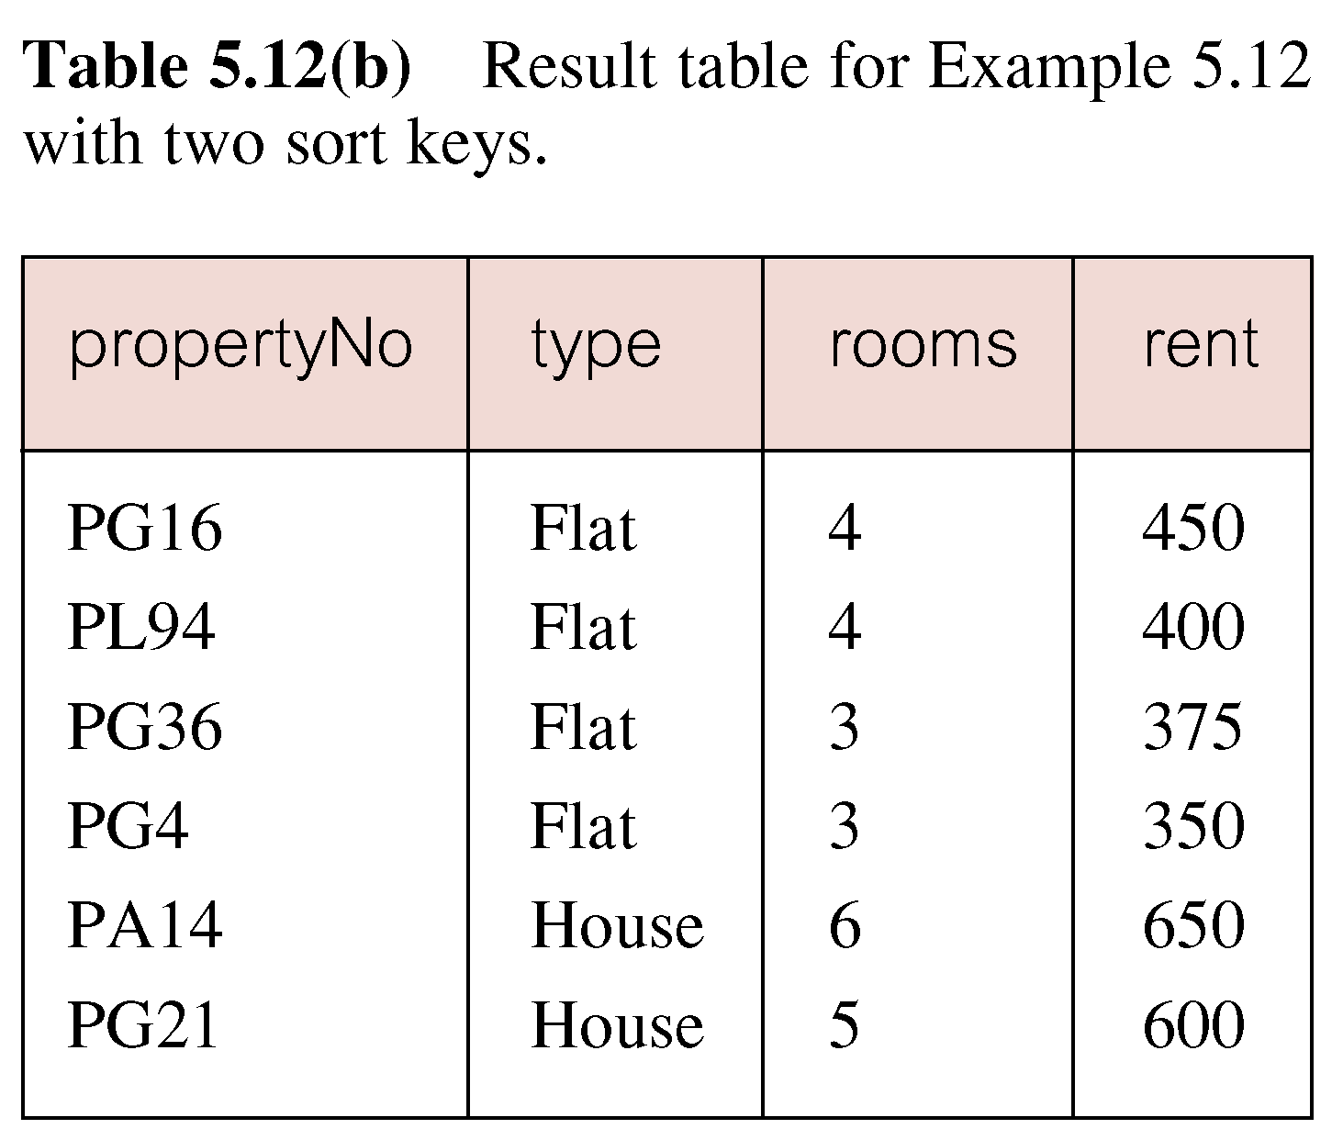
Example 5.12 Multiple Column Ordering

Slide 54
SELECT Statement - Aggregates
AGGREGATE Functions: Used to summarize data on a query, report, or form
ISO standard defines five aggregate functions:
COUNT(*) returns the number of rows in a table.
SUM returns sum of values in specified column.
AVG returns average of values in specified column.
MIN returns smallest value in specified column.
MAX returns largest value in specified column.

Slide 55
SELECT Statement - Aggregates
Each operates on a single column of a table and return single value.
COUNT, MIN, and MAX apply to numeric and non-numeric fields, but SUM and AVG are used on numeric fields only.
Apart from COUNT(*), each function eliminates nulls first and operates only on remaining non-null values.

Slide 56
SELECT Statement - Aggregates
COUNT(*) counts all rows of a table, regardless of whether nulls or duplicate values occur.
Can use DISTINCT before column name to eliminate duplicates.
DISTINCT has no effect with MIN/MAX, but may have with SUM/AVG.

Slide 57
SELECT Statement - Aggregates
Aggregate functions can be used only in SELECT list and in HAVING clause.
If SELECT list includes an aggregate function and there is no GROUP BY clause, SELECT list cannot reference a column out with an aggregate function. For example, following is illegal:
SELECT staffNo, COUNT(salary)
FROM Staff;

Slide 58
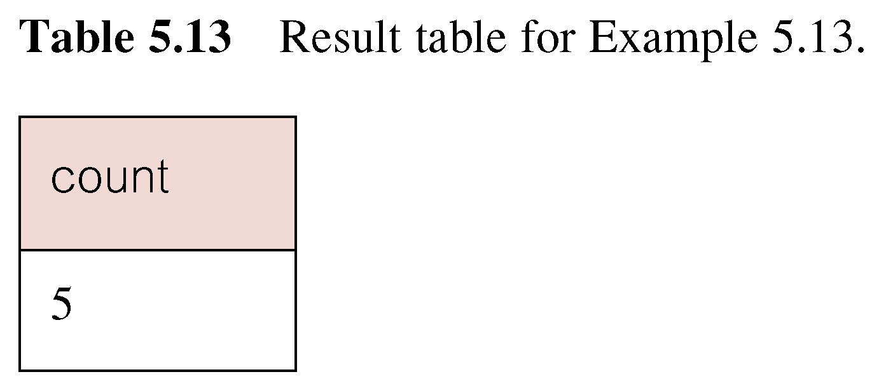
Example 5.13 Use of COUNT(*)
How many properties cost more than 350 per month to rent?
SELECT COUNT(*) AS count
FROM PropertyForRent
WHERE rent > 350;

Slide 59
COUNT
Find the number of staff who belong to branchno=b005?
SELECT COUNT(*)
FROM staff
WHERE branchno = ‘b005’;

Slide 60
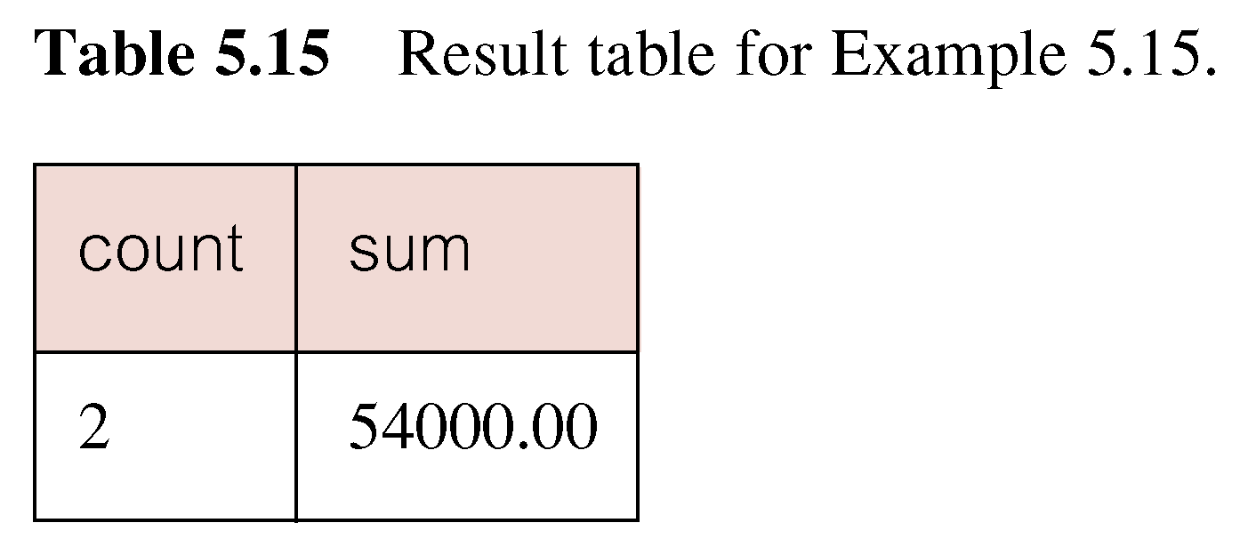
Example 5.15 Use of COUNT and SUM
Find number of Managers and sum of their salaries.
SELECT COUNT(staffNo) AS count,
SUM(salary) AS sum
FROM Staff
WHERE position = 'Manager';

Slide 61
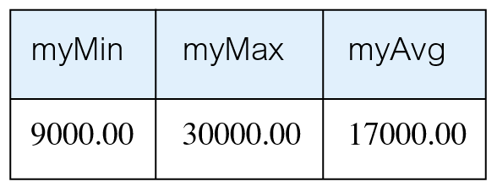
Example 5.16 Use of MIN, MAX, AVG
Find minimum, maximum, and average staff salary.
SELECT MIN(salary) AS myMin,
MAX(salary) AS myMax,
AVG(salary) AS myAvg
FROM Staff;

Slide 62
SQL Statements- Summary
SELECT
Data Retrieval
CREATE , ALTER, DROP, RENAME, TRUNCATE
Data definition Language (DDL)‏
INSERT, UPDATE, DELETE
MERGE
Data Manipulation Language (DML)‏
GRANT, REVOKE
Data Control Language (DCL)‏

Slide 63
SQL Statements cont’d
Statement
Description
SELECT
Retrieves data from the database
CREATE , ALTER, DROP, RENAME, TRUNCATE
Sets up, changes and removes data structures from tables
INSERT, UPDATE, DELETE
Enters new rows, changes existing rows and removes unwanted rows from tables in a database
COMMIT, ROLLBACK, SAVEPOINT
Manages changes made by DML. Changes to data may be grouped into logical transactions
GRANT, REVOKE
Gives and removes access rights to both the database and the structures within it.

Slide 64
Creating a Table
Involves using the CREATE TABLE statement which includes:
Specifying a table name [mandatory]
Defining columns of the table [mandatory]
Column data type [mandatory]
( Data types help in identifying what type of data that can be represented in a data element)
Column constraints [optional]
eg . Not Null , Primary Key, Check , Foreign key
Providing a default value [optional]
SQL
4.

Slide 65
Creating Table Syntax
CREATE TABLE table_name
(
column_name data_type [column_constraint] [DEFAULT expr] , ….….
[, table_constraints]
)‏
Example - considering only mandatory specifications.
CREATE TABLE emp (emp_id number, name varchar(30));
SQL
4.

Slide 66
Create Table – using the DEFAULT option
Example:
Write an SQL statement to create the following tables
CREATE TABLE students (regNo varchar(15), name varchar(20), dob date, gender char(1) default ‘M’);
Confirm table creation. using
DESCRIBE students;
SQL
4.

Slide 67
INSERT
INSERT INTO TableName [ (columnList) ]
VALUES (dataValueList)
columnList is optional; if omitted, SQL assumes a list of all columns in their original CREATE TABLE order.
Any columns omitted must have been declared as NULL when table was created, unless DEFAULT was specified when creating column.

Slide 68
INSERT Syntax
INSERT INTO "table_name" ("column1", "column2", ...) VALUES ("value1", "value2", ...)
E.g. Inserting data into the Students’ Table
INSERT INTO students
VALUES('S001','Kanaye','1980-08-12', 'M');

Slide 69
Inserting Data Into the Table
The INSERT statement

Slide 70
Exercise
Write an SQL statement to create the following tables
Branch(branchNo, street, city, postcode)‏
Staff(staffNo, fName, lName, position, sex, DOB, salary)‏

Slide 71
Inserting Data Into the Table
General Syntax:
INSERT INTO TableName [ (columnList) ]
VALUES (dataValueList)
or
INSERT INTO "table_name" ("column1", "column2", ...) VALUES ("value1", "value2", ...)
E.g. Inserting data into the Students’ Table
INSERT INTO students
VALUES('S001','Katto,'1980-08-12', 'M');

Slide 72
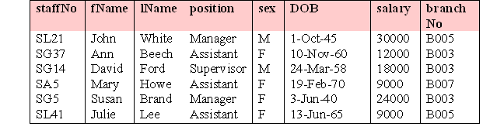
Example 5.35 INSERT … VALUES
Insert a new row into Staff table supplying data for all columns.
INSERT INTO Staff
VALUES (‘SG16’, ‘Alan’, ‘Brown’, ‘Assistant’, ‘M’, ‘1957-05-25’, 8300, ‘B003’);

Slide 73
Solution
Decide on the data types for the different attributes. I.e.
Find out the data types supported by MySQL DBMS
Attribute | Data type | FieldSize
regNo | Varchar | 10
fName | Varchar | 30
lName | Varchar | 30
course | Varchar | 10
age | Integer

